Slide 1
Lecture 15

Slide 2
Question

Slide 3
E

Slide 4
E

Slide 5
Question
What do we call a light wave that has an E-filed that oscillates in just one direction?
Confined
Polarized
Linear
Confocal
E

Slide 6
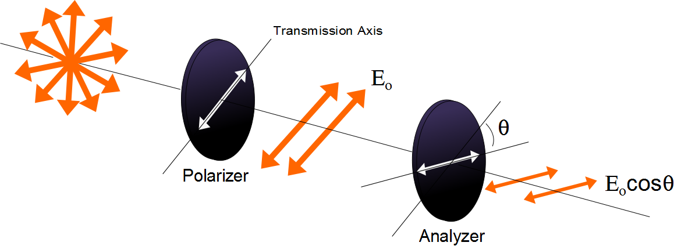

Slide 7
Question
I have two polarizers. If I pass light through both of them and their axes are aligned at 90 degrees from each other how much of the original light comes through?
All of it
30%
70%
None of it

Slide 8
E
Incident Beam
Reflected Beam
θ₁
θ₁
n₁
n₂
Transmitted Beam
θ₂

Slide 9
Electron disturbance in SHM

Slide 11
E
Reflected Beam
Has only the
perpendicular
polarization
Incident Beam
θ_{b}
θ_{b}
n₁
90°
n₂
Transmitted Beam
θ₂

Slide 12
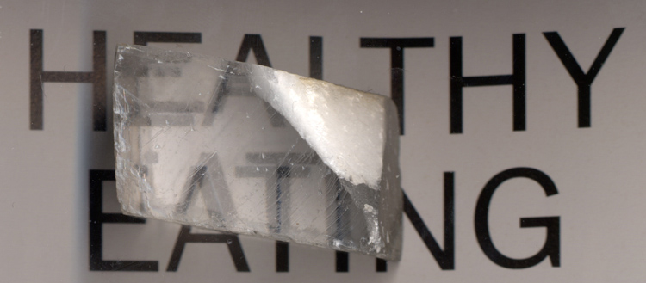

Slide 13
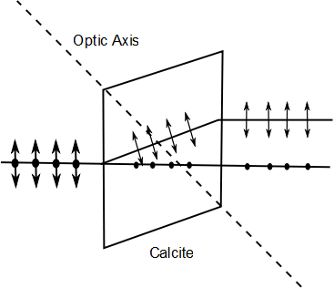
E-ray
Unpolarized Light
O-ray

Slide 14
Polarization by Double Refraction, Rays
The ordinary (O) ray is characterized by an index of refraction of n_{o}
This is the same in all directions
The second ray is the extraordinary (E) ray which travels at different speeds in different directions
Characterized by an index of refraction of n_{E} that varies with the direction of propagation

Slide 15
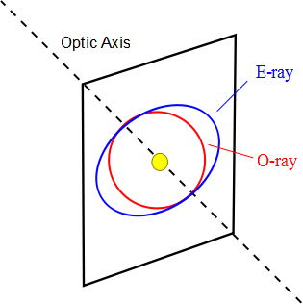

Slide 16
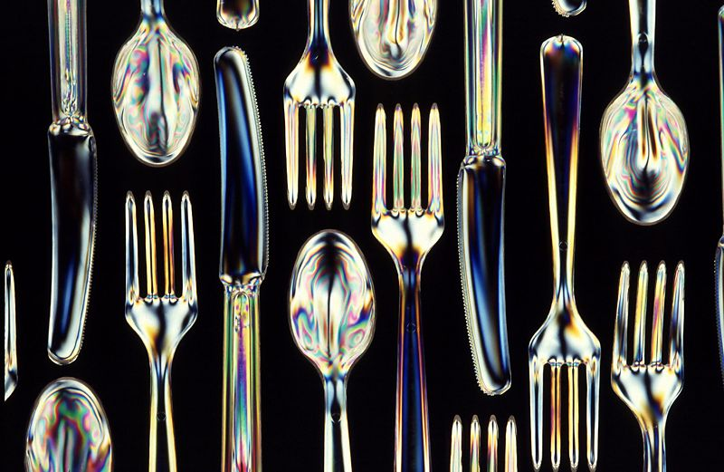
Optical Stress Analysis

Slide 17
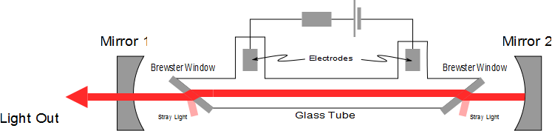
Laser Polarization

Slide 19
Question 223.16.7
Diving masks often have a lens built into the glass for divers who do not have perfect vision. This allows the individual to dive without the necessity for glasses, because the lenses in the faceplate perform the necessary refraction to provide clear vision. The proper design allows the diver to see clearly with the mask on both under water and in the open air. Normal eyeglasses have lenses that are curved on both the front and rear surfaces. The lenses in a diving mask should be curved
only on the front surface
only on the rear surface
on both the front and rear surfaces

Slide 20
Question 223.16.8
Consider a flat mirror. Which of the following is true?
The image is as far behind the mirror as the object is in front
The image is twice as far away as the object is from the mirror
The image is farther away, but you would need to know the particular circumstances to know how far.
The image is in the same place as the object.

Slide 21
Question 223.16.9
What is the magnification of a flat mirror
1
2
-1
½
The image is unmagnified

Slide 22
Question 223.16.10
When you look in a flat mirror you observe
Left right reversal
Top bottom reversal
Front back reversal
No reversal

Slide 23
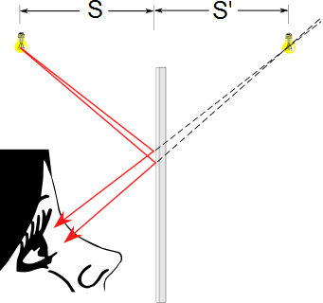
Flat Mirrors
Simplest possible mirror
Light rays leave the source and are reflected from the mirror
Point I is called the image of the object at point O
The image is virtual
O
I

Slide 24
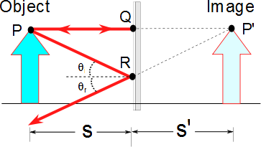
Flat Mirrors
One ray starts at point P, travels to Q and reflects back on itself
Another ray follows the path PR and reflects according to the law of reflection

Slide 25
Images Formed by Flat Mirrors, 4
To observe the image, the observer would trace back the two reflected rays to P’
Point P’ is the point where the rays appear to have originated
The image formed by an object placed in front of a flat mirror is as far behind the mirror as the object is in front of the mirror
|s| = |s’|

Slide 26
Lateral Magnification
Lateral magnification, M, is defined as
This is the general magnification for any type of mirror
It is also valid for images formed by lenses
Magnification does not always mean bigger, the size can either increase or decrease
M can be less than or greater than 1

Slide 27
Lateral Magnification of a Flat Mirror
The lateral magnification of a flat mirror is 1
This means that h’ = h for all images

Slide 28
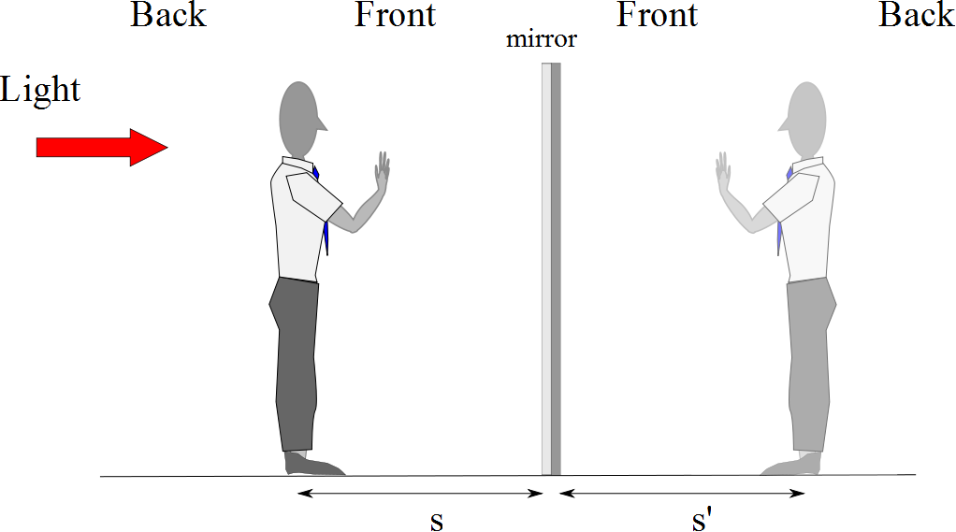
Reversals in a Flat Mirror

Slide 29
Reversals in a Flat Mirror

Slide 30
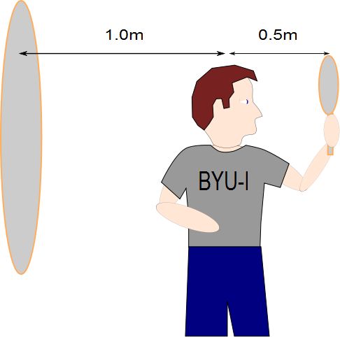
Question 223.13.11
The image of the man’s face in the small mirror will be half a meter away. How far away from the large mirror will the image of this image be?
Half a meter
A meter
1.5 meters
2 meters
What are you talking about?

Slide 31
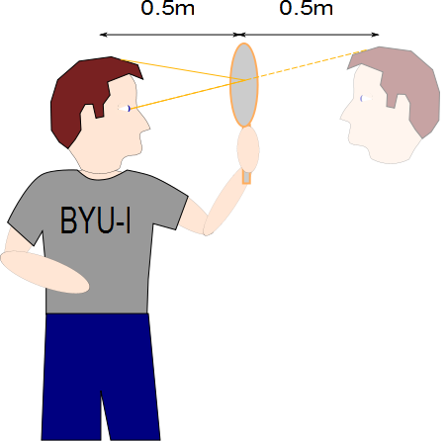

Slide 32
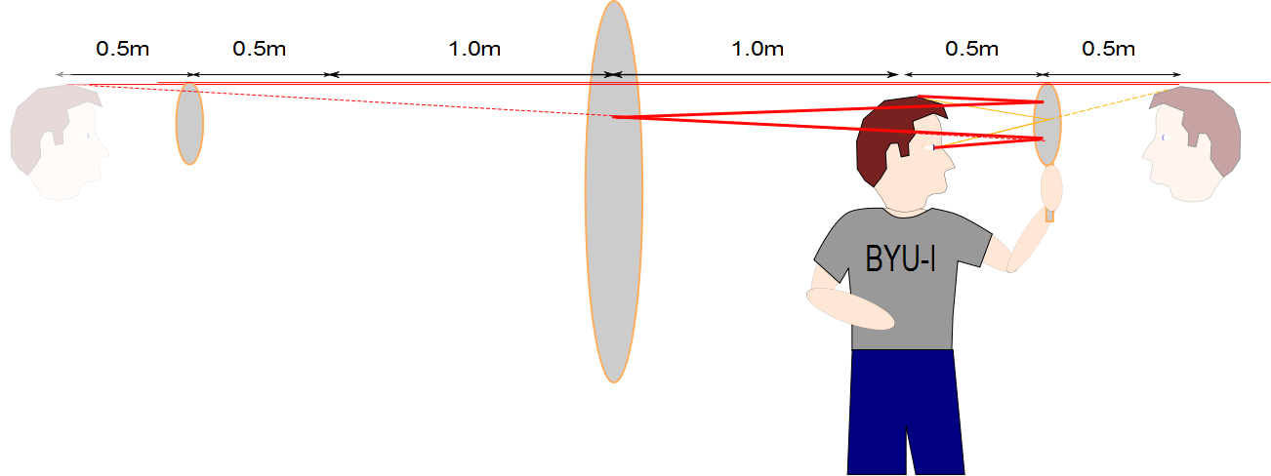

Slide 34
END

Slide 37
Question 35.7.5
Parallel light rays cross interfaces from medium 1 into medium 2 and then into medium 3. What can we say about the relative sizes of the index of refraction of these media?
n₁ > n₂ > n₃
n₃ > n₂ > n₁
n₂ > n₃ > n₁
n₁ > n₃ > n₂
none of the above
1
2
3

Slide 39
Lens
Image
Light Source

Slide 40
Fish out of water
Rays from fish head
Eyes
d
Rays from fish tail

Slide 41
Fish out of water
Rays from fish
Eyes
d
Rays from fish
Fish in water
Image of Fish
Rays appear to come from here
d’

Slide 42
s
s’
Rays from fish
Fish in water
ℓ
Image of Fish
θ₂
θ₁
ℓ
θ₁
θ₂
Rays appear to come from here
n₁ (Large)
n₂ (Small)

Slide 43
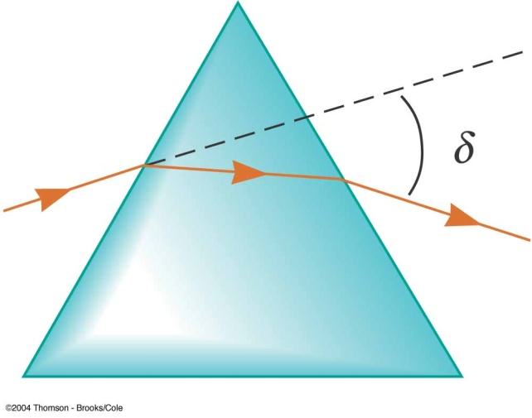
Question 223.15.1
Consider the prism to your right. If we illuminate it with white light, which color will be at the top of the rainbow?
Red
Yellow
Green
Blue
Violet

Slide 44
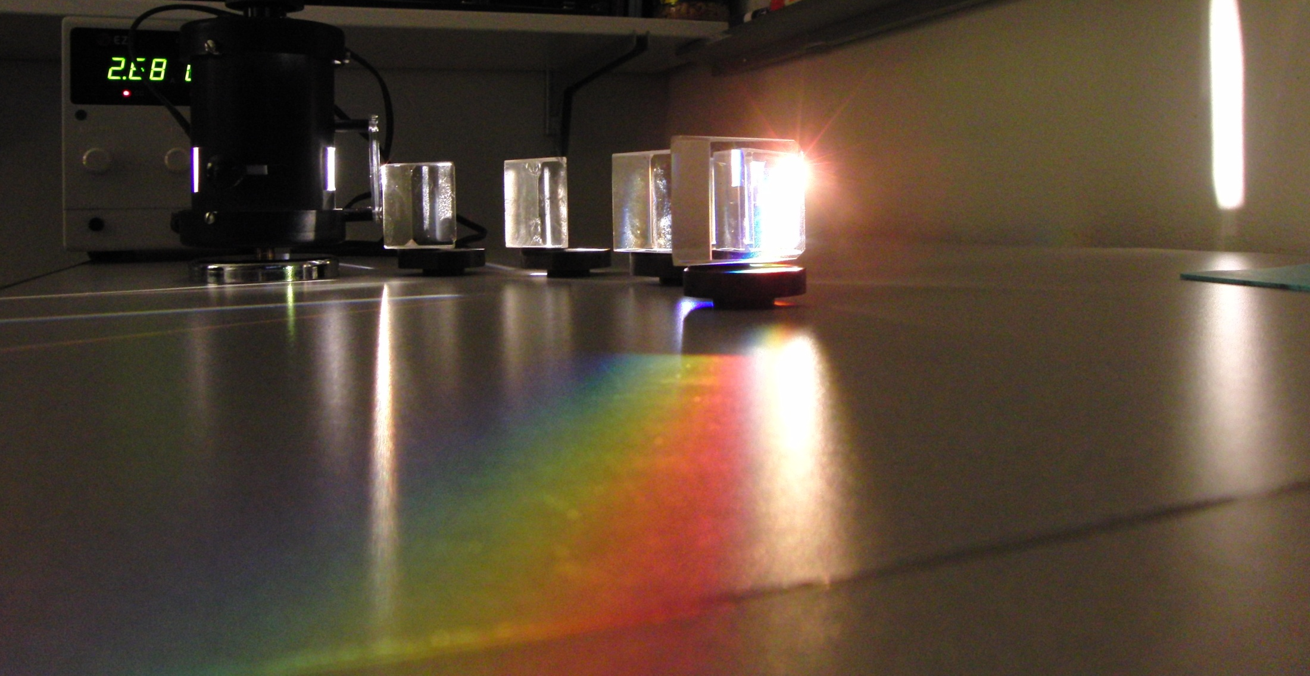

Slide 45
δ_{R}
White Light
δ_{B}
Red
Blue

Slide 46
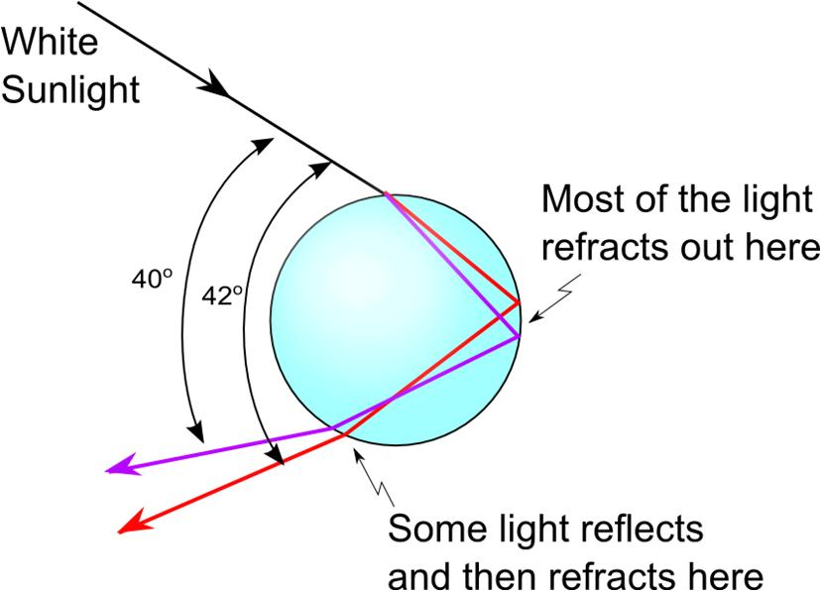

Slide 47
Finding δ
Φ/2
δ
η
φ
φ
φ
β
θ₂
α
α
θ₁
θ₂
θ₂
n

Slide 48
Question 223.15.2
You build a prism out of a thin walled container filled with water. If the water prism is immersed in a tank of water, does it still make a rainbow?
Yes
No
Can’t tell

Slide 49
Question 223.15.3
You are building a camera with refractive lenses. Would you expect all colors of light to focus at the same point?
Yes
No
Can’t tell

Slide 50
